Slide 1


RUFT : Reliable UDP File Transfer
Gianmarco Bencivenni 0218205
Cristina Ionne 0224462

Slide 2







AN OUTER VISION OF SOFTWARE ARCHITECTURE AND LOGIC - 1
RUFT CLIENT SIDE
RUFT SERVER SIDE
COMMAND MENU: THE CLIENT SIDE MUST CHOOSE AMONG THE THREE OPERATIONS LIST, GET, PUT
RECEPTION ENVIRONMENT’S TASK IS TO DIRECT ANY REQUEST TO THE RIGHT ENVIRONMENT. IF THE REQUEST IS A LIST COMMAND, THEN HANDLES IT.
DOWNLOAD ENVIRONMENT: IS RESPONSIBLE FOR RECEIVING A FILE FROM THE SERVER DIRECTORY AND SAVING IT INTO THE CLIENT DIRECTORY.
DOWNLOAD ENVIRONMENT: IS RESPONSIBLE FOR SENDING A FILE FROM THE SERVER DIRECTORY TO THE CLIENTS’S.
UPLOAD ENVIRONMENT: IS RESPONSIBLE FOR SENDING A FILE FROM THE CLIENT DIRECTORY TO THE SERVER’S.
UPLOAD ENVIRONMENT: IS RESPONSIBLE FOR RECEIVING A FILE FROM THE CLIENT DIRECTORY AND SAVING IT INTO THE SERVER DIRECTORY.

Slide 3
AN OUTER VISION OF SOFTWARE ARCHITECTURE AND LOGIC - 2
TYPE SRC ADDRESS - PORT (*) FILE NAME
VIEW REQUEST
LIST IP1-PORT P
WELL KNOWN RECEPTION PORT
RECEPTION SOCKET.
UPLOAD REQUEST
PUT IP2-PORT X PAPEROGA
SERVER’S INTERNAL STRUCTURE IS LOGICALLY DIVIDED INTO THREE COMMUNICATING PARTS, EACH ONE MATCHES A SPECIFIC REQUEST TYPE.
OF COURSE SERVER’S INTERNAL STRUCTURE IS NOT VISIBLE TO THE CLIENT, WHO JUST COMMUNICATES WITH THE RECEIVING SERVER’S SOCKET.
THIS SOFTWARE CONSISTS IN A CLIENT-SERVER UDP APPLICATION.
RELIABLE DATA TRANSFER IS IMPLEMENTED WITHIN THE APPLICATION LAYER.
CLIENTS CAN SEND VISUALIZATION/UPLOAD/DOWNLOAD REQUESTS TO SERVER .
DOWNLOAD REQUEST
GET IP3-PORT F FILENAME1

Slide 4
SERVER ARCHITECTURE : ENVIRONMENTS-BASED SUBDIVISION
Main Thread has the RECEPTIONIST TASKS:
Keep all requests from clients.
If request is a «list» request (type 0), then serves it.
If request is a «download» or «upload» request (types 1 / 2), delegates a new special thread-worker serving it.
CLIENTS REQUESTS
MAIN THREAD «RECEPTION ENVIRONMENT»
TYPE == 2
SRC ADDRESS and FILE NAME
SERVER ANSWERS (list) / ACKNOWLEDGMENTS
SOCKET 1
PORT 54321
«UPLOAD ENVIRONMENT»
TYPE == 1
SRC ADDRESS and FILE NAME
«DOWNLOAD ENVIRONMENT»
TYPE == 0
list:
File1
File2
…
File N
FILE DIR
Buffer-cache containing updated list of current files in server’s directory
UPDATES DUE TO CLIENTS’ UPLOADS
EXECUTE OPERATIONS …

Slide 5
SERVER ARCHITECTURE : ENVIRONMENTS-BASED SUBDIVISION
?
IS A POOL OF SPECIALIZED THREADS.
EACH THREAD IS LOGICALLY CONTAINED INTO A BLOCK, SERVING REQUESTS ON A SPECIFIC FILE, THROUGH HIS BLOCK’S SOCKET.
EACH BLOCK IS DINAMICALLY ALLOCATED, AND MANTAINS A TIMER PROPORTIONAL TO THE NUMBER OF ACTIVE THREADS WORKING ON THAT BLOCK, AND FILE SIZE. AT TIMEOUT THE BLOCK IS DEALLOCATED AND MEMORY IS SET FREE.
EACH BLOCK CAN CONTAIN A MAX NUMBER OF THREADS, EITHER THEY ARE CURRENTLY WORKING OR NOT.
THIS ENVIRONMENT STRUCTURE IS THOUGHT TO EMPHASYZE THE PRINCIPLE OF TIME LOCALITY.
DOWNLOAD REQUEST
PASSED TO THE DOWNLOAD ENVIRONMENT
NEW
«DOWNLOAD ENVIRONMENT»
ATTACH AS NEXT BLOCK
OR ADD CONTENTS TO AN EXISTING BLOCK
«RECEPTION ENVIRONMENT»
«DOWNLOAD – BLOCK» STRUCTURE
FILE NAME
FILE BUFFER CACHE
LINKED LIST OF MAX NUM «WORKERS»
BLOCK-LIFE-TIMER
MAXIMUM NUMBER OF CONCURRENT THREADS
SOCKET ID AND PORT NUMBER
THREAD ID
CLIENT IP
CLIENT PORT
IS_WORKING
THE MAXIMUM NUMBER OF CONCURRENT THREADS IS A CASE OF STUDY PARAMETER: WHAT WE NEED TO GET THE BEST EFFICIENCY ON COMPUTER RESOURCES IS TO BALANCE THE NUMBER OF BLOCKS REFERENCING THE SAME FILE AND THE MAX NUMBER OF THREADS OF EACH BLOCK (USING THE SAME SOCKET AT THE SAME TIME).
FILE DIR
…
«DOWNLOAD SOCKET» N° i
PORT i
FILE TRANSFER TO CLIENTS

Slide 6


DOWNLOAD ENVIRONMENT SUMMARY
[ SERVER SIDE ]
RECEPTION ENVIRONMENT ( MAIN THREAD)
IN THIS CASE SERVER WORKS AS A SENDER, CLIENT IS THE RECEIVER.
RECEPTION EVIRONMENT COMMUNICATES DOWNLOAD ENVIRONMENT THE INCOMING REQUESTS.
IF THERE IS NO BLOCK MATCHING THE REQUEST’S FILE NAME, A NEW BLOCK IS CREATED ( A NEW LINE IN TABLE BELOW)
EACH REQUEST IS ASSOCIATED TO A FREE THREAD OF A BLOCK.
DWNLD
IP 1
PORT X
FILENAME 1
CLIENT 1
SLIDING WINDOW ( 1.1 )
SLIDING WINDOW ( 1.2 )
FILE BUFFER CACHE
LIFE TIMER COUNT DOWN
*NEXT
FILE NAME 1
THREAD 1. 1
THREAD 1.2
THREAD 1.3
DWNLD
IP 2
PORT Y
FILENAME 1
FILE BUFFER CACHE
LIFE TIMER COUNT DOWN
FILE DIR
CLIENT 2
*NEXT
FILE NAME 2
THREAD 2.1
THREAD 2.2
THREAD 2.3
SLIDING WINDOW ( 3.1 )
FILE BUFFER CACHE
LIFE TIMER COUNT DOWN
*NEXT
FILE NAME 3
THREAD 3.1
THREAD 3.2
THREAD 3.3
DWNLD
IP 3
PORT F
FILENAME 3
CLIENT 3
NULL
NULL
NULL
DOWNLOAD ENVIRONMENT

Slide 7

CONCERNING TIMERS : DOWNLOAD ENVIRONMENT
BLTC : Block Life Timer Countdown
AS A NEW BLOCK (REFERENCING A FILE STREAM) IS ALLOCATED, A BLTC VARIABLE IS DECLEARED. THE DEFAULT VALUE OF THIS TIMER IS PROPORTIONAL TO THE NUMBER OF PACKETS REQUIRED TO TRANSFER THE FILE, THAT IS :
FILESIZE (BYTES) / PACKETSIZE (BYTES)
THE PROPORTIONALITY FACTOR HAS TO BE A FRACTION OF SECONDS, AND THIS SHOULD BE A CONFIGURABLE PARAMETRIC VALUE, NAMED «TAO».
FURTHER, BLTC IS DINAMICALLY INCREMENTED BY THE NUMBER OF TOTAL ACCESSES TO THE FILE ( DUE TO CLIENTS’ REQUESTS ), SO THAT THE EQUATION WOULD FINALLY BE :
BLTC = ( NUMPACKET + ACCESSES ) tao
IN EXAMPLE, IF THE TRANSFERRED FILE SIZE IS 4 KB, AND PACKET SIZE IS 512 B, AND THE NUMBER OF TOTAL ACCESSES IS CURRENTLY 2 ( AS THE FIRST LINE CASE ON THE TABLE ON THE SIDE ), THEN THE BLTC VALUE WOULD BE :
BLTC = ( 4096 / 512 ) + 2 = 8 + 2 = 10 tao.
THE COUNTSDOWN ACTUALLY STARTS WHEN ALL THREADS OF THE BLOCK HAS FINISHED THEIR TASKS ( AS THE SECOND LINE CASE ON THE TABLE ON THE SIDE ) :
IF THE TIMER RUNS OUT AND NO NEW REQUESTS HAS BEEN KEPT BY THE BLOCK, THE LATTER IS DEALLOCATED WITH ALL SUBSTRUCTURES AND WORKING THREADS.
ELSE, IF A ONE OR MORE NEW REQUEST ARE KEPT BY THE BLOCK WHILE TIMER IS STILL RUNNING, THE TIMER IS RESET TO HIS LAST VALUE + NUMBER OF NEW ACCESSES. WHEN ALL OF THESE REQUESTS HAVE BEEN SERVED, TIMER STARTS AGAIN WITH ITS NEW VALUE.
SLIDING WINDOW ( 1.1 )
SLIDING WINDOW ( 1.2 )
FILE BUFFER CACHE
LIFE TIMER COUNT DOWN
FILE NAME 1
THREAD 1. 1
THREAD 1.2
THREAD 1.3
FILE BUFFER CACHE
LIFE TIMER COUNT DOWN
FILE NAME 2
THREAD 2.1
THREAD 2.2
THREAD 2.3
SLIDING WINDOW ( 3.1 )
FILE BUFFER CACHE
LIFE TIMER COUNT DOWN
FILE NAME 3
THREAD 3.1
THREAD 3.2
THREAD 3.3
NULL
NULL
NULL

Slide 8
RDT : SLIDING WINDOW PROTOCOL IMPLEMENTATION. SENDER
THE SEQUENCE NUMBER REPRESENTS THE POSITION OCCUPIED BY A PACKET WITH RESPECT TO THE OTHERS, WITHIN THE FILE THAT’S BEING TRANSMITTED.
SEQUENCE NUMBER IS DEFINED IN AN INTEGER
RANGE :
{ 0 ; ( FILESIZE (bytes) / PACKETSIZE (bytes) ) }
THE SLIDING WINDOW HAS A SIZE OF N:
THAT MEANS AT MOST N PACKETS ARE ALLOWED
TO BE ON-THE-FLY AT THE SAME TIME, WITHOUT
ACKNOWLEDGMENT.
GOING-TO-BE-SENT PACKETS CAN BE TEMPORARILY STORED INTO A READY-QUEUE, WAITING THE WINDOW TO BE FREE.
TIMER
EACH PACKET HAS A TIMEOUT COUNTER. AS THE COUNTDOWN REACHES THE 0 AND NO ACKS HAVE BEEN DETECTED FOR THAT PACKET, THEN IT IS TO BE SENT AGAIN.
THE APPLICATION HAS TO SIMULATE THE LOSS OF PACKET WITH A PROBABILITY OF «P», RUNTIME-SET PARAMETER.
RECEIVING ACKS
WHEN AN ACKNOWLEDGMENT IS RECEIVED BY THE CLIENT SIDE, THE RESPECTIVE ENTRY WITHIN THE SLIDING WINDOW IS MARKED AS ACKED.
IF THE ENTRY IS LOCATED AT THE BEGINNING OF THE SLIDING WINDOW, THEN THE WINDOW SLIDES UP.
CIRCULAR BUFFER (OF SIZE N) IMPLEMENTS THE SLIDING WINDOW STRUCTURE :
EVERY TIME A NEW PACKET HAS TO BE SENT, IF THE BUFFER IS NOT «FULL», PACKET’S SEQUENCE NUMBER IS ASSIGNED TO THE FIRST FREE SLOT IN THE CIRCULAR BUFFER ( FOLLOWING THE ORDER FROM THE START), AND THE PACKET IS SENT.
AS THE CIRCULAR BUFFER GETS FILLED, IT WOULDN’T BE POSSIBLE TO TRANSMIT NEW PACKETS, UNTILL ONE OR MORE CONSECUTIVE BEGINNING-SLOTS ARE ACKNOWLEDGED BY THE SERVER SIDE.
ONCE THIS EVENT OCCURS, THE «X» CONSECUTIVE ACKNOWLEDGED SLOTS ARE SET FREE, THUS THE BUFFER SLIDES LEFT OF «X», THE START INDEX IS INCREMENTED OF X % N, AND THE WINDOW HAS «X» FREE SLOTS TO BE USED BY NEW PACKETS TO BE SENT.
STRUCT SW_SLOT
int sequence_number;
int status;
//FREE = 0 | SENT = 1 | ACKED = 2
char retransmission;
char is_first;
struct timespec
sent_timestamp;
acked_timestamp;
sw_slot next;
START
BEGINNING-SLOT

Slide 9
RDT : SLIDING WINDOW PROTOCOL IMPLEMENTATION. SENDER
DOWNLOAD-BLOCKS EXAMPLE
EACH OF THE DOWNLOAD-BLOCKS REFERS TO A SPECIFIC FILE STORED IN SERVER’S DIRECTORY.
THE FILE IS PUT INTO A STREAM ( BUFFER CACHE ) AND SHARED BY A NUMBER OF CLIENTS TRYING TO DOWNLOAD IT.
FOR EACH CLIENT SHOULD BE POSSIBLE CREATING AD-HOC SLIDING WINDOW OPERATING ON SHARED PACKETS.
EACH WINDOW IS OF COURSE MATCHED WITH THE BLOCK’S OUTPUT SOCKET, SO IT HAS TO BE SHARED TOO.
PACKET SIZE
0
1
2
3
…
M-2
M-1
M
FILE BUFFER CACHE
STRUCT SW_SLOT
int sequence_number;
int status;
//FREE = 0 | SENT = 1 |ACKED = 2
char retransmission;
char is_first;
struct timespec
sent_timestamp;
acked_timestamp;
sw_slot next;
START
START
START
START
WINDOW 1 : CLIENT 1
WINDOW 2 : CLIENT 2
WINDOW 3 : CLIENT 3
WINDOW 4 : CLIENT 4

Slide 10

Reliable Data Transfer : IMPLEMENTATION ORIENTED BLOCK-STRUCTURE’S UPGRADE
IN ORDER TO IMPLEMENT THE RELIABLE DATA TRANSFER LOGIC, IT HAS BEEN NECESSARY THE IMPROVEMENT OF BLOCK’S ARCHITECTURE ITSELF.
LIFE TIMER COUNT DOWN
FILE BUFFER CACHE
NEW
FILE NAME
ACKNOWLEDGMENT
KEEPER THREAD
*NEXT
NEW
NEW
NEW
TIME WIZARD THREAD
TIME WIZARD THREAD
TIME WIZARD THREAD
EACH WORKER THREAD, WHEN INITIALIZED, HAS AN ASSOCIATED TIME WIZARD THREAD WHO CONSTANTLY CHECKS THE SLIDING WINDOW SLOTS: IT SLEEPS AND WAKES UP EVERY BEAT NANOSECONDS TO CHECK IF A CERTAIN SLOT HAS BEEN IN THE ‘SENT’ STATUS FOR MORE THAN THE TIMEOUT INTERVAL. IF IT DOES, THEN THE RETRANSMISSION FUNCTION IS CALLED BY THE TIME WIZARD THREAD.
TIME WIZARD THREAD

Slide 11
Reliable Data Transfer : IMPLEMENTATION ORIENTED BLOCK-STRUCTURE’S UPGRADE
IN ORDER TO IMPLEMENT THE RELIABLE DATA TRANSFER LOGIC, IT HAS BEEN NECESSARY THE IMPROVEMENT OF BLOCK’S ARCHITECTURE ITSELF.
LIFE TIMER COUNT DOWN
FILE BUFFER CACHE
NEW
FILE NAME
ACKNOWLEDGMENT
KEEPER THREAD
*NEXT
NEW
NEW
NEW
TIME WIZARD THREAD
TIME WIZARD THREAD
TIME WIZARD THREAD
ACCORDING TO THE RDD APPROACH ( RESPONSIBILITY DRIVEN DESIGN ), EACH THREAD SHOULD HAVE A PRECISE TASK.
THE ACKNOWLEDGMENT KEEPER THREAD IS AN ADDICTIVE THREAD FOR EVERY BLOCK IN DOWNLOAD ENVIRONMENT.
ITS TASK IS TO BE CONTINOUSLY RECEIVING DATA FROM BLOCK’S SOCKET : FOR SURE, EACH RECEIVED MESSAGE OF A DOWNLOAD ENVIRONMENT’S BLOCK IS AN ACK.
THE KEEPER TAKES THE PACKET, UNDERSTANDS WHICH WORKER IT IS RELATED TO, AND UPDATES THAT WORKER’S SLIDING WINDOW’S SLOT STATUS TO «ACKED».
FURTHER, IF THIS WINDOW’S SLOT IS THE FIRST OF THE SLIDING WINDOW, THE KEEPER FORWARD A SIGNAL TO THE SPECIFIC WORKER, WHO AWAKES FROM A PAUSE AND SLIDES THE WINDOW ON, AND GOES ON WITH THE TRANSFER.
ACKNOWLEDGMENT
KEEPER THREAD

Slide 12

Reliable Data Transfer : IMPLEMENTATION ORIENTED BLOCK-STRUCTURE’S UPGRADE
STEP 3 - AKNOWLEDGMENT KEEPER
RECEIVES ACKNOWLEDGMENTS ADDRESSED TO EVERY WORKER OF THE BLOCK.
ACCESSES THE REFERRED WORKER.
ACCESSES THE REFERRED WINDOW’S SLOT, UPDATING THE ATTRIBUTE STATUS VALUE TO ACKED.
IF THE SLOT IS THE FIRST OF THE WINDOW, SIGNALS THE WORKER TO SLIDE THE WINDOW ON AND CONTINUE WITH TRANSFER.
SEQ NUM
STATUS
IS FIRST
CHAR * PACKET
TIMEOUT INTERVAL
SENT TIMESTAMP
ACKED TIMESTAMP
ACKNOWLEDGMENT
KEEPER THREAD
( one for each block)
ACK ( X, i )
PACKET ( i )
STEP 2 - CLIENT
RECEIVES FILE PACKETS AND NOTIFY SERVER WITH ACKNOWLEDGMENTS.
STEP 1 - THE WORKER
BUILDS THE PACKET ( i ) AND SETS IT AS ATTRIBUTE «PACKET» OF SLIDING WINDOW’S SLOT ( i ).
SETS THE ATTRIBUTE «STATUS» OF WINDOW’S SLOT TO «SENT».
SENDS THE PACKET ( i ) TO THE CLIENT.
SETS THE ATTRIBUTE «SENT TIMESTAMP» OF WINDOW’S SLOT TO THE CURRENT TIMESTAMP .
WORKER THREAD
«X»
STEP 1 - THE TIME WIZARD
WHILE WORKER THREAD IS RUNNING ( TRANSMITTING PACKETS ) THE TIME WIZARD THREAD REPEATS THE FOLLOWING CYCLE :
NANO-SLEEPS ( CLOCK TIMER )
COMPARES THE CURRENT TIMESTAMP WITH THE SENDING-TIMESTAMP OF EACH SLOT OF THE SLIDING WINDOW:
IF ( SLOT’S STATUS == SENT ) AND ( ( CURRENT TIMESTAMP – SENT TIMESTAMP ) >= TIMEOUT INTERVAL )
THEN PACKET HAS TO BE RESENT TO THE CLIENT, AND SLOT’S SEDNING_TIMESTAMP IS UPDATED WITH THE CURRENT_TIMESTAMP.
TIME WIZARD THREAD

Slide 13
CONCERNING TIMERS : ESTIMATED RTT & ADAPTIVE TIMEOUT SETTINGS
THE MEASURED ROUND TRIP TIME ( RTT ) IS DEFINED AS THE TIME BETWEEN THE FORWARDING OF THE PACKET AND THE ARRIVAL OF RELATED ACKNOWLEDGMENT.
THE EXAMPLE BELOW SHOWS THE CASE WHERE ONE OR MORE PACKETS, SENT TO THE RECEIVER, ACTUALLY DO NOT REACH THE DESTINATION, THEREFORE THEY ARE NOT ACKED BACK.
0
1
2
3
…
M-2
M-1
M
…
SENT
SENT
SENT
SENT
…
SENDER’S SOCKET
RECEIVER’S SOCKET
SLIDING WINDOW
SEQUENCE NUMBER = 0
SEQUENCE NUMBER = 1
X
SEQUENCE NUMBER = 2
RTT
START
END
X
SEQUENCE NUMBER = 3
STRUCT SW_SLOT
int sequence_number;
int status;
//FREE = 0 | SENT = 1 |ACKED = 2
char retransmission;
char is_first;
struct timespec
sent_timestamp;
acked_timestamp;
sw_slot next;
IN SUCH A SITUATION, SLIDING WINDOW PROTOCOL PROVIDES FOR WAITING THE FORWARDING OF THE SAME PACKET BY THE SENDER, BUT ONLY AFTER HE HAS WAITED FOR A CERTAIN TIME :
IF THE TIMER RUNS OUT TOO EARLY, THE RISK IS TO OPERATE A NOT NECESSARY RETRANSMISSION.
IF THE TIMER RUNS OUT TOO LATE, IT TAKES TO A LOW-PERFORMANCE SCENARIO.
FOR THESE REASONS IS NECESSARY TO SET A TIMEOUT INTERVAL THAT LASTS A LITTLE MORE THAN THE ROUND TRIP TIME. THEREFORE, NEXT STEPS ARE ESTIMATE RTT VALUE AND CALCULATE THE TIMEOUT INTERVAL.
…
SENT
ACKED
SENT
ACKED
…

Slide 14
CONCERNING TIMERS : ESTIMATED RTT & ADAPTIVE TIMEOUT SETTINGS
THE FOLLOWING SOLUTION IS THE SAME ADOPTED BY TCP, BUT IS IMPLEMENTED ON THE APPLICATION LAYER.
STEP 1 : ESTIMATED RTT & DEV RTT
IN ORDER TO GET A REALISTIC VALUE OF ESTIMATED RTT, IT’S NECESSARY THE MEASURE OF SAMPLE RTT ON EACH PACKET TRANSMITTED ONCE.
THE ESTIMATED RTT VALUE IS GAINED BY A WEIGHTED AVERAGE ON PREVIOUS ESTIMATED RTT VALUE AND THE NEW MEASURED SAMPLE RTT VALUE:
ESTIMATED RTT = ( 0.875 * ESTIMATED RTT ) + ( 0.125 * SAMPLE RTT )
A MAJOR WEIGHT IS GIVEN TO THE PREVIOUS VALUE OF ESTIMATED RTT, FOLLOWING THE PRINCIPLE OF TIME LOCALITY.
FURTHER, IT IS NECESSARY TO CONSIDER THE VARIABILITY OF THE ROUND TRIP TIME
( DEV RTT ) : IT ESTIMATES THE DIFFERENCE BETWEEN THE NEW VALUE OF SAMPLE RTT AND THE ESTIMATED RTT VALUE.
DEV RTT = ( 0.75 * DEV RTT ) + ( 0,25 * ( SAMPLE RTT – ESTIMATED RTT ) )
CODE LEVEL IMPLEMENTATION
THE <TIME.H> LIBRARY WAS USED TO GET THE TIME MEASUREMENTS:
CLOCK_GETTIME() FUNCTION TO GET THE CURRENT TIMESTAMP
NANODIFFTIME FUNCTION TAKES TWO TIMESTAMPS AND CALCULATES THE DIFFERENCE (IN NANOSECONDS) BETWEEN THEM
UPDATE_ADAPTIVE_TIMEOUT_INTERVAL FUNCTION IS THE ONE FUNCTION THAT REALLY MANAGE THE ADAPTIVE TIMEOUT: IT USES THE TWO FUNCTIONS ABOVE TO CALCULATE THE SAMPLE RTT VALUE AND APPLY IT TO THE FORMULAS
int update_adaptive_timeout_interval( sw_slot *packet ) {
long sampleRTT = nanodifftime( &( packet -> acked_timestamp ),
&( packet -> sent_timestamp ) );
if( EstimatedRTT == 0) EstimatedRTT = sampleRTT;
EstimatedRTT = (0.875 * EstimatedRTT ) + ( 0.125 * sampleRTT );
DevRTT = ( 0.75 * DevRTT ) + ( 0.25 * ( sampleRTT – EstimatedRTT ) );
TIMEOUT_INTERVAL = EstimatedRTT + ( 4 * DevRTT );
return 0;
}
STEP 2 : TIMEOUT INTERVAL
IT IS NOW POSSIBLE TO CALCULATE DINAMIC VALUES OF RETRANSMISSION TIMEOUT INTERVAL.
THE TRICK IS TO CALCULATE A TIMEOUT INTERVAL VALUE SUCH THAT IT DEVIATES A FEW FROM ESTIMATED RTT IF THERE’S NO TRAFFIC IN THE NET, BUT MUCH OTHERWISE.
TIMEOUT INTERVAL = ESTIMATED RTT + ( 4 * DEV RTT )

Slide 15




UPLOAD ENVIRONMENT
AS AN UPLOAD REQUEST IS RECEIVED BY THE RECEPTION ENVIRONMENT, AN UPLOAD ENVIRONMENT’S BLOCK HAS TO BE SIGNALED, TO SERVE THE NEW CLIENT’S REQUEST. EACH BLOCK OF THE UPLOAD ENVIRONMENT IS LINKED TO THE FOLLOWING, AND SERVES ONLY ONE CLIENT PER CYCLE.
IN HERE, THE BLOCK LOGIC IS REPRESENTED AND DESCRIBED IN ALL ITS COMPONENTS.
THE RECEPTIONIST THREAD UPDATES THE DYNAMIC FIELDS OF THE BLOCK INSTANCE, CHOSEN TO SERVE THE UPLOAD REQUEST.
THE DYNAMIC FIELDS CONSIST IN THE CLIENT ADDRESS ITSELF AND THE FILENAME OF THE NEW UPLOADING FILE. ONCE THESE FIELDS HAVE BEEN UPDATED, THE RECEPTIONIST PUT A TOKEN IN THE SEMAPHORE ARRAY AND LET THE SLEEPING UPLOADER AND WRITER RUN OUT THE SERVICE.
PREVIOUS BLOCK
UPLOADER THREAD
THE UPLOADER IS RESPONSIBLE FOR THE EXECUTION OF RELIABLE FILE TRANSFER, RECEIVER SIDE (ACKS TO THE CLIENT, ACCORDING TO THE SELECTIVE REPEAT ALGORITHM).
RECEIVING WINDOW
A RECEIVING WINDOW IS SHARED, FOR EACH BLOCK, BY THE UPLOADER AND WRITER THREADS.
WRITER THREAD
THE WRITER IS RESPONSIBLE FOR WRITING THE NEW FILE ON SERVER’S DIRECTORY, AND TO SLIDE THE BLOCK’S RECEIVING WINDOW ON.
EACH UPLOAD BLOCK HAS AN OWN SOCKET TO COMMUNICATE WITH CLIENT SIDE. WHENEVER A CLIENT ASKS THE RECEPTION FOR AN UPLOAD SERVICE, THE RECEPTIONIST CHOSES A FREE UPLOAD BLOCK (WITH SLEEPING THREADS), SETTING UP HIS NEW DYNAMIC PARAMETERS.
THIS IS A CONNECTIONLESS TRANSFER, SO THE CLIENT WILL KNOW WHO IS THE TARGET OF UPLOAD WHEN THE RUFT SERVER’S UPLOAD ENVIRONMENT SENDS HIM THE SIGNAL TO PROCEDE.
CLIENT ADDRESS
ADDRESS LENGHT
FILEPATH
NEXT BLOCK

Slide 16
UPLOAD ENVIRONMENT : WHAT’S WRONG?
THE ARCHITECTURE OF UPLOAD ENVIRONMENT HAS AN IMPORTANT UPPER BOUND, WHICH DOESN’T HAVE TO BE KEPT EASY: SCALABILITY.
THE SYSTEM IS IMPLEMENTED TO BE CONFIGURED IN LOTS OF PARAMETERS, INCLUDING THE UPLOAD ENVIRONMENT’S POOL SIZE (NUMBER OF AVAILABLE BLOCKS).
IN THE OTHER HAND, THERE’S NOT A DYNAMIC MECHANIC TO HANDLE THE RUNTIME INCREMENT OF CLIENT’S PUT REQUESTS!
POOL SIZE M = MAX NUMBER OF CLIENTS SIMOLTANEOUSLY SERVED
POSSIBLE SOLUTION : PRIORITY QUEUE FOR INCOMING REQUESTS
USER (M+1)
«SERVER UNAVAILABLE, RETRY LATER…»
. . .

Slide 17
RDT : SLIDING WINDOW PROTOCOL IMPLEMENTATION. RECEIVER
RECEIVER SIDE, SLIDING WINDOW PROTOCOL REQUIRES A RECEIVING WINDOW OF THE SAME SIZE OF SENDER’S SLIDING WINDOW. THUS, THE SAME (OR REALLY SIMILAR) STRUCTURE EXPLAINED FOR SENDER’S SIDE IS ADOPTED IN HERE.
AS A PACKET IS RECEIVED:
IF ITS SEQUENCE NUMBER IS ONE CONTAINED WITHIN THE RECEIVING WINDOW, THEN RECEIVER REPLIES THE SENDER WITH A SELECTIVE ACKNOWLEDGMENT.
IF ITS SEQUENCE NUMBER IS ONE CONTAINED WITHIN THE RECEIVING WINDOW BUT THE SLOT SIGNALS IT HAS ALREADY BEEN RECEIVED, YET THE RECEIVER REPLIES THE SENDER WITH A SELECTIVE ACKNOWLEDGMENT.
IF ITS SEQUENCE NUMBER MATCHES THE BEGINNING-SLOT’S SEQUENCE NUMBER, THE RECEIVING WINDOW SLIDES LEFT OF A NUMBER OF POSITIONS EQUAL TO THE CONSECUTIVE SLOTS (FROM THE BEGINNING) HAVING STATUS EQUAL TO «RECEIVED», AND RECEIVING WINDOW IS UPDATED WITH NEW SEQUENCE NUMBERS.
IF ITS SEQUENCE NUMBER IS NOT CONTAINED WITHIN THE RECEIVING WINDOW, THEN THE RECEIVER IGNORES THE PACKET.
STRUCT RV_SLOT
int sequence_number;
int status;
//WAITING = 3 | RECEIVED = 4
char is_first;
char *packet
sw_slot next;
START
BEGINNING-SLOT

Slide 18
Reliable Data Transfer : IMPLEMENTATION ORIENTED BLOCK-STRUCTURE
SEQ NUM
STATUS
IS FIRST
CHAR * PACKET
CLIENT ADDRESS
ADDRESS LENGHT
FILEPATH
PACKET ( i )
STEPS - THE UPLOADER
AFTER BEING AWAKEN FROM ITS SLEEP, NOTIFIES THE CLIENT IT’S READY TO BEGIN THE TRANSACTION. FROM NOW ON, THE UPLOADER RECEIVES PACKETS FROM HIS OWN BLOCK’S SOCKET.
WHEN THE PACKET (i) IS RECEIVED, CHECKS THE SEQUENCE NUMBER VALUE TO SEE IF THE RECEIVING WINDOW CONTAINS IT:
IF THERE’S AN EMPTY SLOT IN RW THAT MATCHES THE SEQUENCE NUMBER, PACKET CONTENT IS LOADED INTO THE RW SLOT, AND AN ACK IS SENT BACK TO THE CLIENT. IF THIS SLOT IS THE FIRST OF THE RW, THE WRITER IS SIGNALED TO WRITE ALL CONSECUTIVES RECEIVED PACKETS CURRENTLY STORED INTO THE RW.
IF THERE’S A FILLED SLOT IN RW THAT MATCHES THE SEQUENCE NUMBER, THEN A SELECTIVE ACK IS SENT.
IF THE SEQUENCE NUMBER DOESN’T MATCH ANY OF THE RECEIVING WINDOW, THEN THE PACKET IS IGNORED.
STEPS - CLIENT
SENDS AN UPLOAD REQUEST TO THE RUFT SERVER, AND WAIT FOR A SIGNAL TO START THE TRASNMISSION.
AS SIGNAL ARRIVES, THE RELIABLE FILE TRANSMISSION BEGINS, ACCORDING TO THE STEPS DESCRIBED FOR SERVER’S DOWNLOAD BLOCKS.
UPLOADER THREAD
STEPS - THE WRITER
WAITS THE UPLOADER TO NOTIFY.
ONCE THE SIGNAL ARRIVES, TAKES CONTROL OF THE RECEIVING WINDOW AND WRITES ALL CONSECUTIVE PACKET CONTENTS OF THE WINDOW ON THE «FILEPATH» FILE.
THEN, RELEASES CONTROL OF RW AND SLIDES THE WINDOW ON.
WRITER THREAD

Slide 19
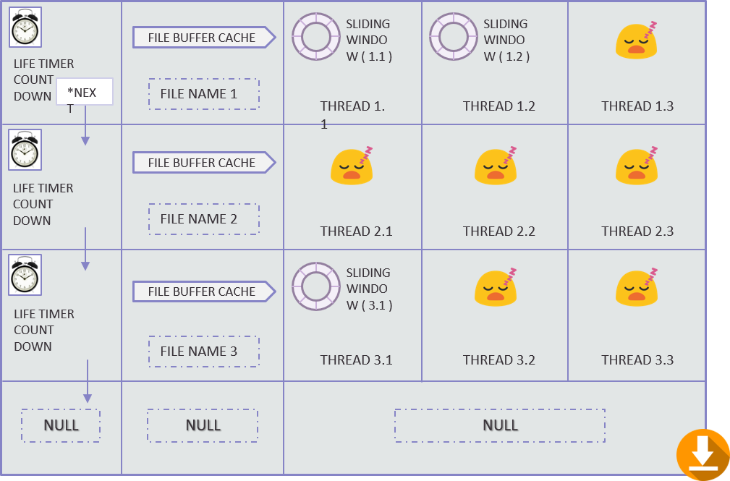
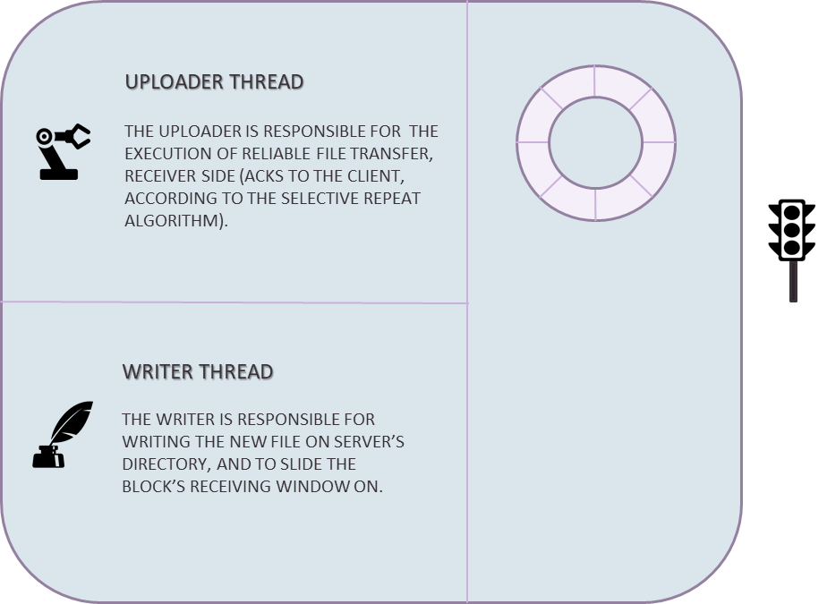
CLIENT SIDE MIRRORS RUFT SERVER’S ARCHITECTURE
RUFT CLIENT SIDE
RUFT SERVER SIDE
COMMAND MENU: THE CLIENT SIDE MUST CHOOSE AMONG THE THREE OPERATIONS LIST, GET, PUT
RECEPTION ENVIRONMENT’S TASK IS TO DIRECT ANY REQUEST TO THE RIGHT ENVIRONMENT. IF THE REQUEST IS A LIST COMMAND, THEN HANDLES IT.
DOWNLOAD ENVIRONMENT: IS RESPONSIBLE FOR RECEIVING A FILE FROM THE SERVER DIRECTORY AND SAVING IT INTO THE CLIENT DIRECTORY.
DOWNLOAD ENVIRONMENT: IS RESPONSIBLE FOR SENDING A FILE FROM THE SERVER DIRECTORY TO THE CLIENTS’S.
UPLOAD ENVIRONMENT: IS RESPONSIBLE FOR SENDING A FILE FROM THE CLIENT DIRECTORY TO THE SERVER’S.
UPLOAD ENVIRONMENT: IS RESPONSIBLE FOR RECEIVING A FILE FROM THE CLIENT DIRECTORY AND SAVING IT INTO THE SERVER DIRECTORY.

Slide 20
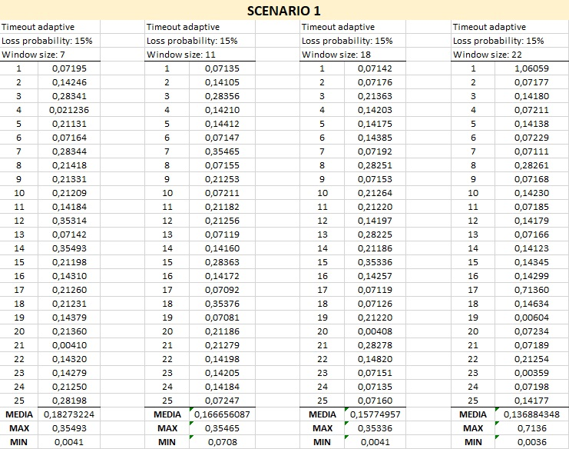
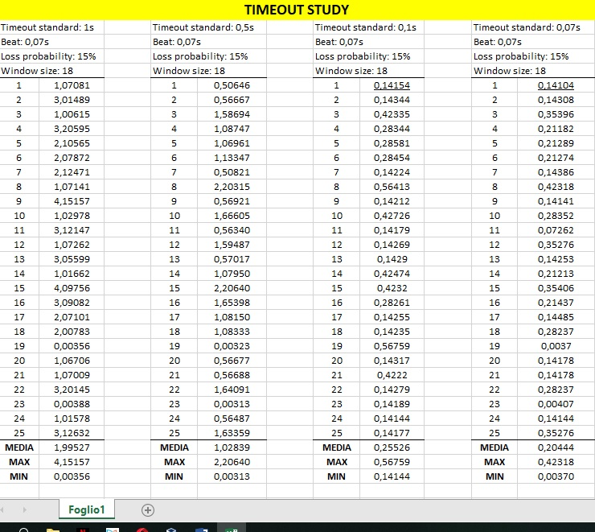
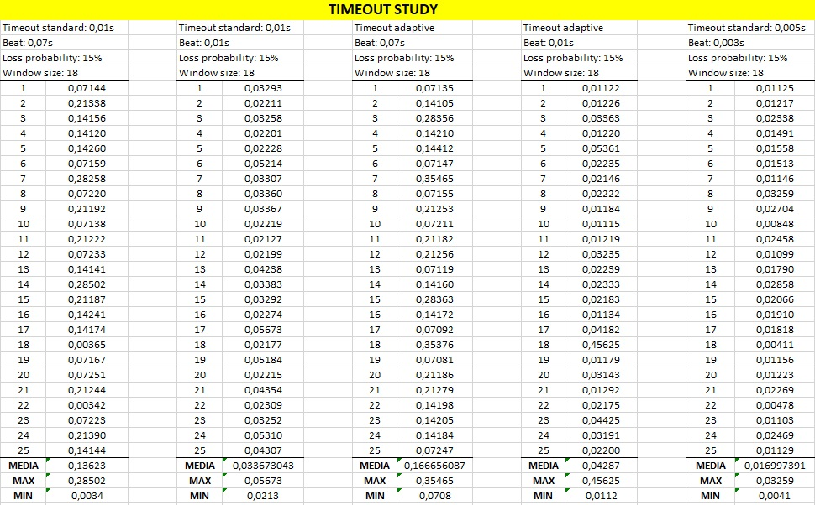
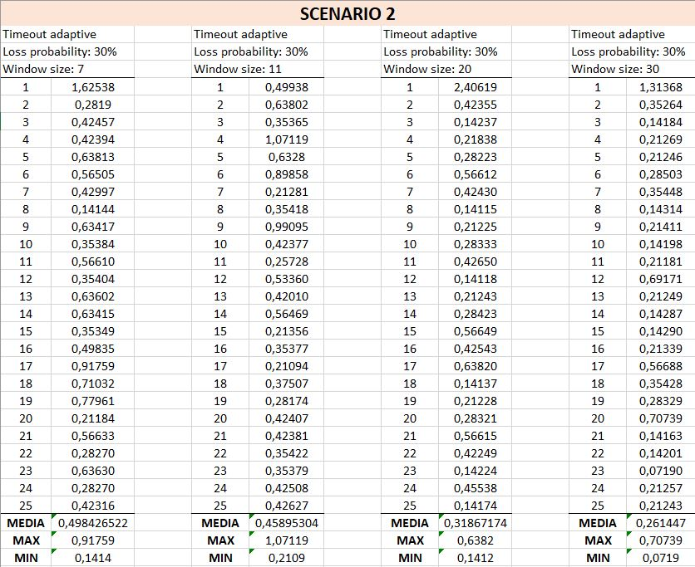
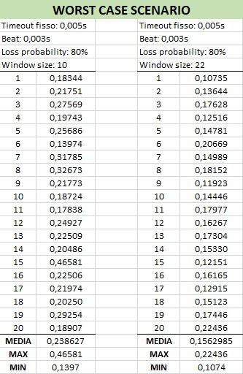
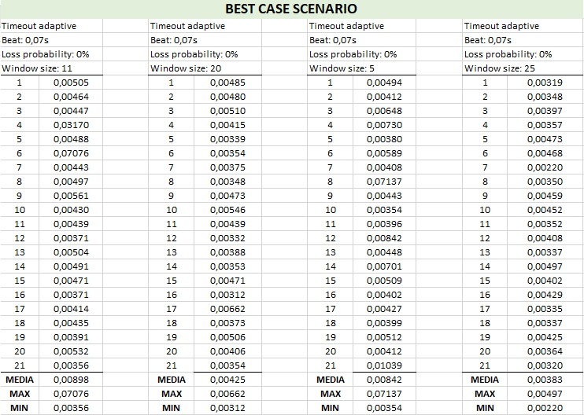


PERFOMANCE ANALYSIS: SCENARIOS AND TIMEOUTS
ADAPTIVE TIMEOUT, 15% OF LOSS PROBABILITY AND VARIABLE SLIDING WINDOW SIZE
THE INCREASE OF THE WINDOW SIZE LEAD TO AN INCREASE OF THE PERFORMANCES: THE COMPLETE TRANSMISSION TIME (STARTING FROM SENDING THE REQUEST TO THE END OF THE OPERATION) DECREASES.
VARIABLE STANDARD TIMEOUT, 15% OF LOSS PROBABILITY AND FIXED SLIDING WINDOW SIZE
ADAPTIVE TIMEOUT, 30% OF LOSS PROBABILITY AND VARIABLE SLIDING WINDOW SIZE
SAME RESULT AS THE PREVIOUS CASE BUT OBVIOUSLY THE PERFORMANCES ARE SLIGHTLY WORSE.
DECREASING THE STANDARD TIMEOUT AND MAKING IT MORE SIMILAR TO THE ADAPTIVE TIMEOUT,
THE PERFORMANCES GET A HUGE IMPROVEMENT.
WORST CASE : FIXED TIMEOUT OF $0,005s$, 80% OF LOSS PROBABILITY AND VARIABLE SLIDING WINDOW SIZE
EVEN IN THE WORST CASE SCENARIO (HIGHLY CONGESTED NETWORK) GOOD PERFORMANCES CAN BE REACHED WITH A FIXED TIMEOUT OF $5ms$, USING A BEAT OF 3ms.
BEST CASE : ADAPTIVE TIMEOUT, 0% OF LOSS PROBABILITY AND VARIABLE SLIDING WINDOW SIZE
THIS CASE IS OBVIOUSLY UNREALISTIC BECAUSE IT’S NEARLY IMPOSSIBLE TO HAVE 0% OF LOSS PROBABILITY ON ANY NETWORK.
«WORST CASE SCENARIO» HAS BEEN MEASURED USING THE BEST TIMEOUT PARAMETER FOUND AFTER THE TIMEOUT STUDY! USING A BEAT OF 3ms AND A FIXED TIMEOUT OF 5ms, ALLOWS QUITE THE MAXIMUM PERFORMANCES OF THIS APPLICATION.
IN THIS WAY, THE WORST CASE OF 80% LOSS PROBABILITY SEEMS TO BE BETTER THAN
OTHER SCENARIOS, BUT IT IS NOT A FAIR COMPETITION IN THAT SENSE!

